Slide 1



Automated Reasoning about Software ($67532$)
Guy Katz
Lecture 5: Binary Decision Diagrams (BDDs) November $25$^{th}, $2019$

Slide 2
Acknowledgements
Some of the material presented has been borrowed from slides by David Dill, Isil Dillig, Gera Weiss, Clark Barrett, Alex Aiken, Mooly Sagiv, Sagar Chaki and Ofer Strichman

Slide 3
Overview
Previous lectures: determine the satisfiability of a propositional formula, find a satisfying assignment
Sometimes, we need to efficiently represent all satisfying assignments to the formula
Binary Decision Diagrams (BDDs): compact representation of all satisfying assignments of a formula

Slide 4

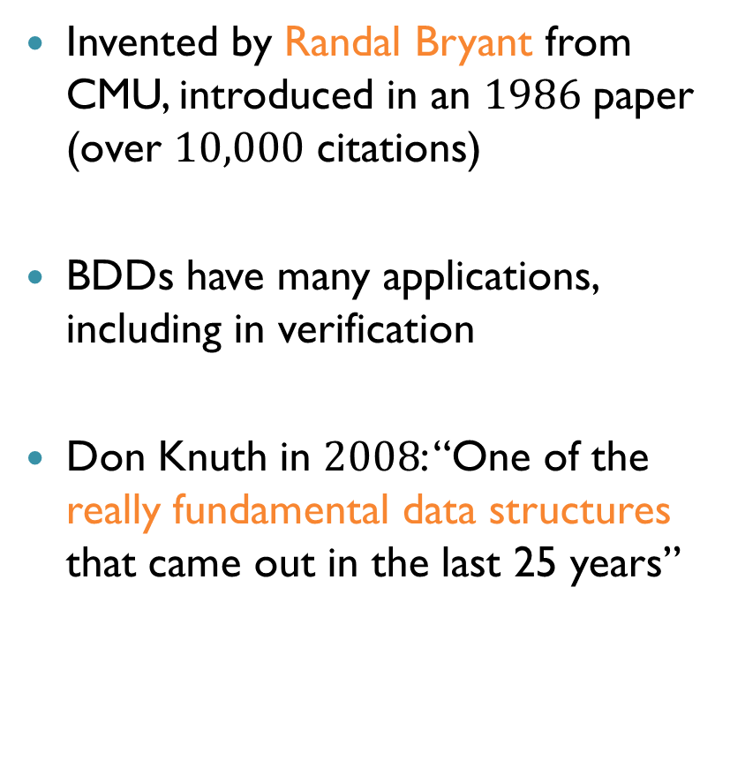
Historical Context
Invented by Randal Bryant from CMU, introduced in an $1986$ paper (over $10,000$ citations)
BDDs have many applications, including in verification
Don Knuth in $2008$: “One of the really fundamental data structures that came out in the last 25 years”

Slide 5

Binary Decision Trees
Before BDDs, let us consider binary decision trees:
A tree data structure
Two kinds of vertices: terminal and non-terminal
Terminal vertices: $T$ or $F$ ($1$ or $0$)
Non-terminal vertex labeled $v$ corresponds to Boolean variable $v$ in a propositional formula

Slide 6
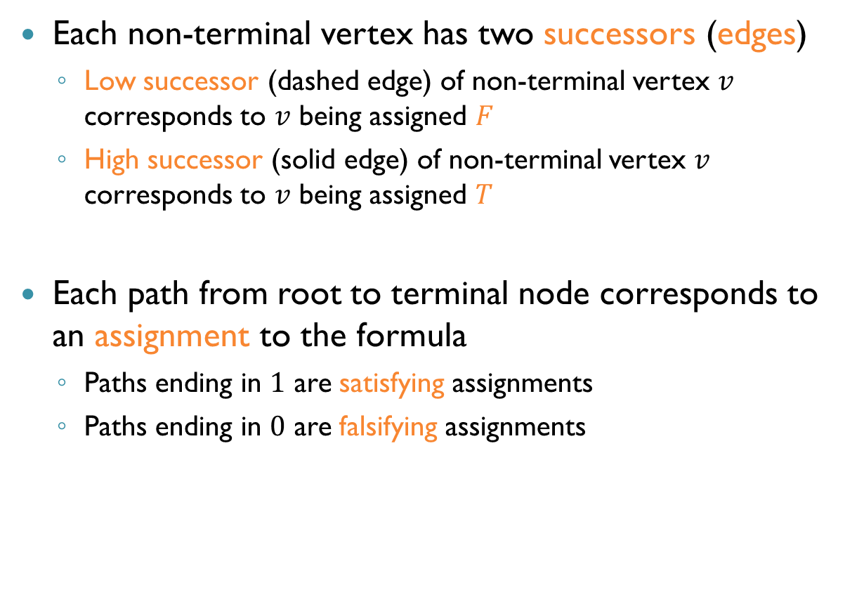
Binary Decision Trees (cnt’d)
Each non-terminal vertex has two successors (edges)
Low successor (dashed edge) of non-terminal vertex $v$ corresponds to $v$ being assigned $F$
High successor (solid edge) of non-terminal vertex $v$ corresponds to $v$ being assigned $T$
Each path from root to terminal node corresponds to an assignment to the formula
Paths ending in $1$ are satisfying assignments
Paths ending in $0$ are falsifying assignments

Slide 7


















Example: Binary Decision Tree
BDT with variables $x_{1},x_{2},x_{3}:$
$x_{1}=x_{2}=F, x_{3}=T$ SAT?
$x_{1}=T, x_{2}=F, x_{3}=T$ SAT?
The BDT is ordered: any path from root to terminal contains variables in the same order
$$x_{1}$$
$$0$$
$$1$$
$$x_{2}$$
$$x_{2}$$
$$x_{3}$$
$$x_{3}$$
$$x_{3}$$
$$x_{3}$$
$$0$$
$$1$$
$$0$$
$$1$$
$$0$$
$$0$$
$$1$$
$$1$$

Slide 8
BDTs Vs. Truth Tables
A BDT encodes all satisfying assignments
How does it compare to a truth table?
Good news: lots of redundancy!
Different parts of the tree are isomorphic
Idea: merge redundant parts into a compressed, space-efficient DAG representation

Slide 9
Reducing a BDT
Start with an ordered BDT, apply reduction rules
Apply rules until saturation (cannot apply any more)
Resulting data structure: a reduced ordered binary decision diagram (ROBDD)
Or just BDD, in short

Slide 10



Reduction Rule $\#1$
Merge all terminal nodes
One terminal for $0$, one terminal for $1$
$$x_{1}$$
$$x_{2}$$
$$x_{2}$$
$$x_{3}$$
$$x_{3}$$
$$x_{3}$$
$$x_{3}$$
$$0$$
$$1$$
$$0$$
$$1$$
$$0$$
$$0$$
$$1$$
$$1$$

Slide 11

Reduction Rule $\#2$
Merge isomorphic subgraphs
Two subgraphs are isomorphic if:
Their roots represent the same variable
The subgraphs rooted at their low successors are isomorphic
The subgraphs rooted at their high successors are isomorphic

Slide 12




Reduction Rule $\#2$ (cnt’d)
$$x_{1}$$
$$x_{2}$$
$$x_{2}$$
$$x_{3}$$
$$x_{3}$$
$$x_{3}$$
$$x_{3}$$
$$x_{3}$$
$$x_{3}$$
$$1$$
$$0$$

Slide 13

Reduction Rule $\#3$
Remove redundant nodes
A node is redundant if its successors are the same
Because its value doesn’t affect the outcome
Remove node, redirect incoming edge to its child

Slide 14



Reduction Rule $\#3$ (cnt’d)
Observe reduction in size: $5$ nodes instead of $16$
$$x_{1}$$
$$x_{2}$$
$$x_{2}$$
$$x_{3}$$
$$x_{3}$$
$$x_{3}$$
$$x_{3}$$
$$1$$
$$0$$

Slide 15


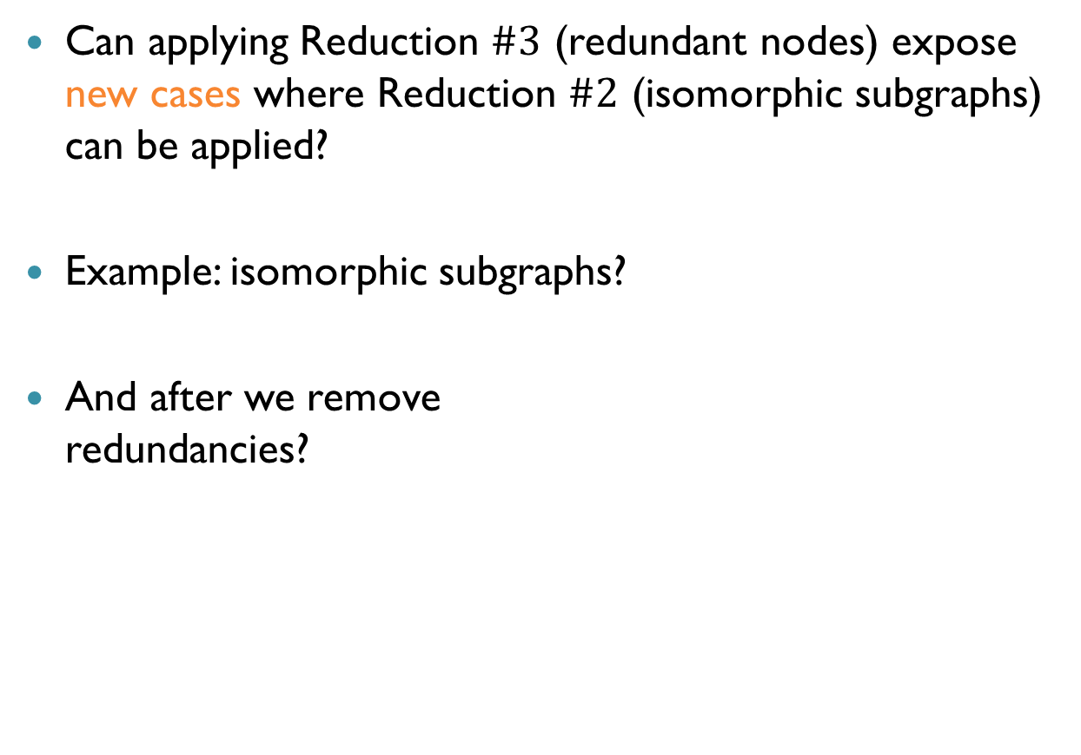

Saturation
Can applying Reduction $\#3$ (redundant nodes) expose new cases where Reduction $\#2$ (isomorphic subgraphs) can be applied?
Example: isomorphic subgraphs?
And after we remove redundancies?
$$x_{1}$$
$$x_{2}$$
$$x_{2}$$
$$x_{3}$$
$$0$$
$$1$$

Slide 16
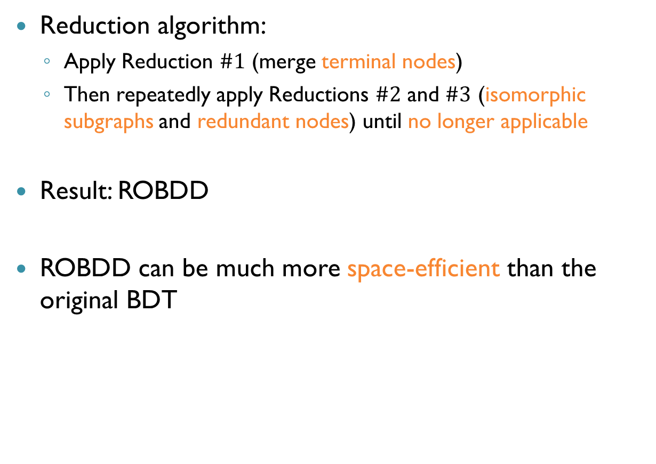
Saturation (cnt’d)
Reduction algorithm:
Apply Reduction $\#1$ (merge terminal nodes)
Then repeatedly apply Reductions $\#2$ and $\#3$ (isomorphic subgraphs and redundant nodes) until no longer applicable
Result: ROBDD
ROBDD can be much more space-efficient than the original BDT

Slide 17
Building BDDs
How can we construct a BDD for a given formula?
Naïve approach:
Build a BDT
Use reductions to transform into a BDD
Not a very efficient way!
Need a way to construct a BDD without going through the BDT!

Slide 18
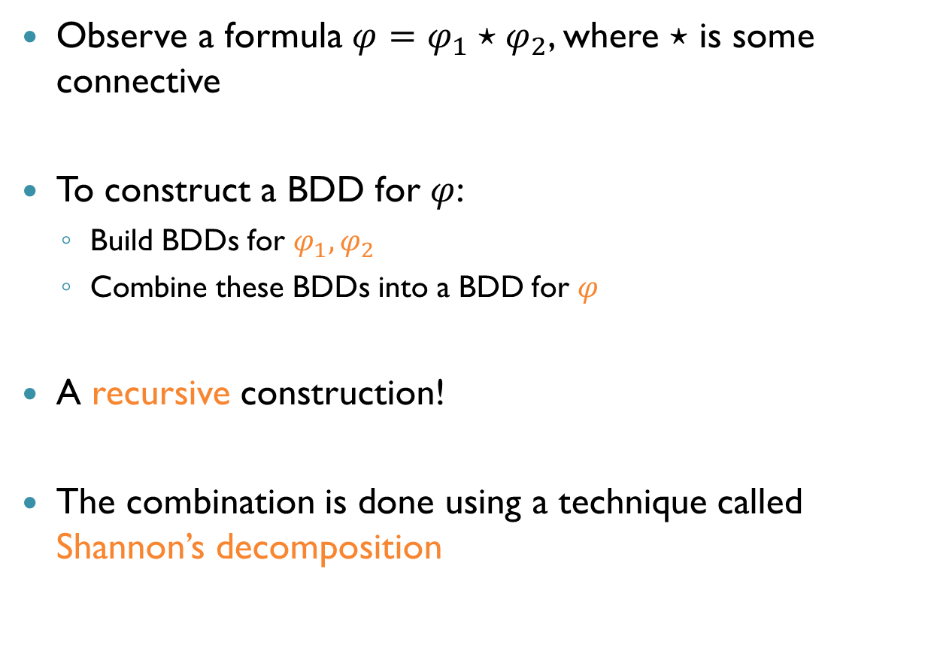
BDDs From Formulas
Observe a formula $φ=φ_{1}⋆φ_{2}$, where $⋆$ is some connective
To construct a BDD for $φ$:
Build BDDs for $φ_{1},φ_{2}$
Combine these BDDs into a BDD for $φ$
A recursive construction!
The combination is done using a technique called Shannon’s decomposition

Slide 19
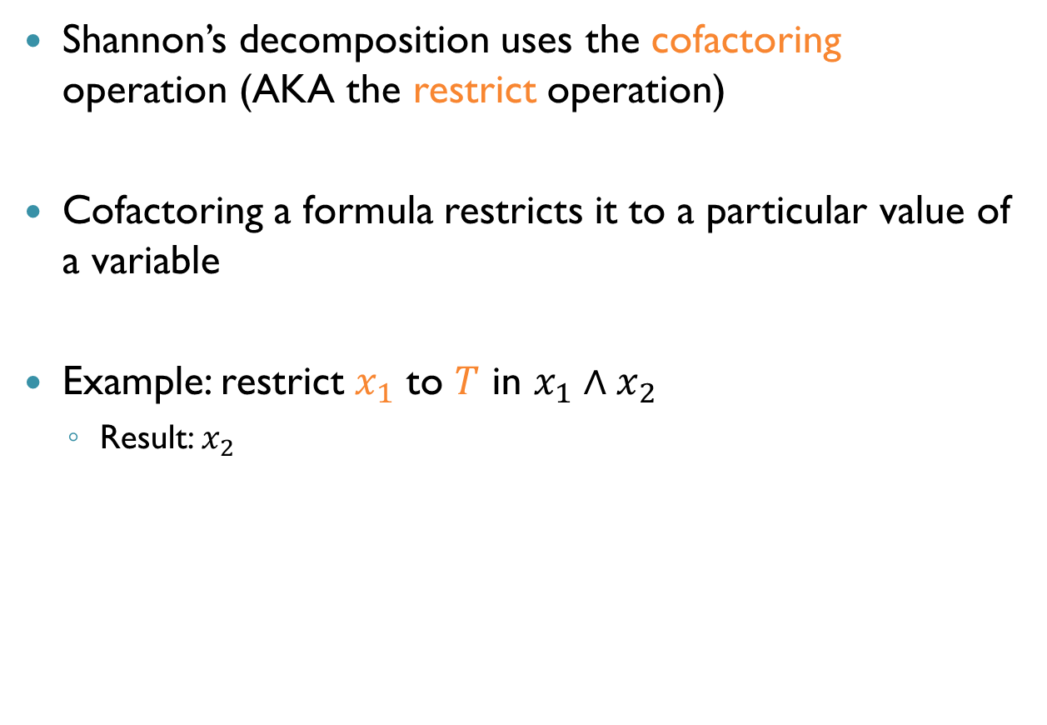
Cofactoring
Shannon’s decomposition uses the cofactoring operation (AKA the restrict operation)
Cofactoring a formula restricts it to a particular value of a variable
Example: restrict $x_{1}$ to $T$ in $x_{1}∧x_{2}$
Result: $x_{2}$

Slide 20
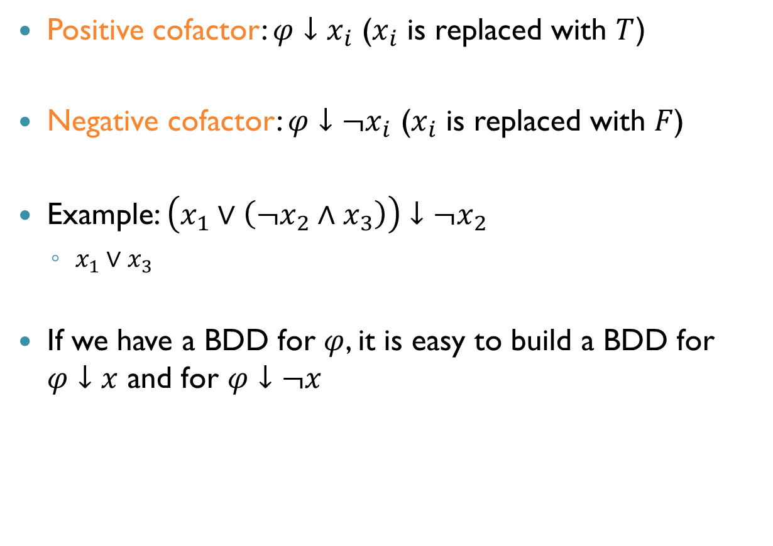
Cofactoring (cnt’d)
Positive cofactor: $φ↓x_{i}$ ($x_{i}$ is replaced with $T$(
Negative cofactor: $φ↓¬x_{i}$ ($x_{i}$ is replaced with $F$)
Example: $\left(x_{1}∨\left({¬x}_{2}∧x_{3}\right)\right)↓¬x_{2}$
$x_{1}∨x_{3}$
If we have a BDD for $φ$, it is easy to build a BDD for $φ↓x$ and for $φ↓¬x$

Slide 21





Cofactoring Example
What is the BDD for $φ↓¬x_{2}$?
$$x_{1}$$
$$x_{2}$$
$$x_{3}$$
$$0$$
$$1$$

Slide 22

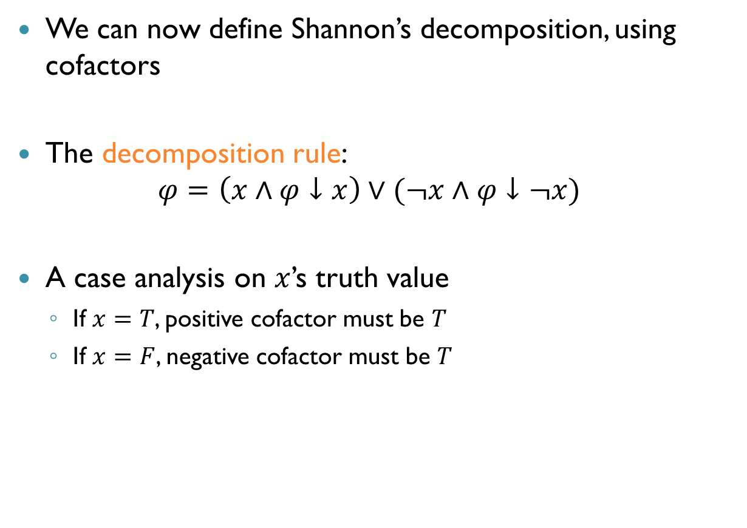
Shannon’s Decomposition
We can now define Shannon’s decomposition, using cofactors
The decomposition rule: $φ=\left(x∧φ↓x\right)∨(¬x∧φ↓¬x)$
A case analysis on $x$’s truth value
If $x=T$, positive cofactor must be $T$
If $x=F$, negative cofactor must be $T$
$$x$$
BDD for negative cofactor
BDD for positive cofactor

Slide 23
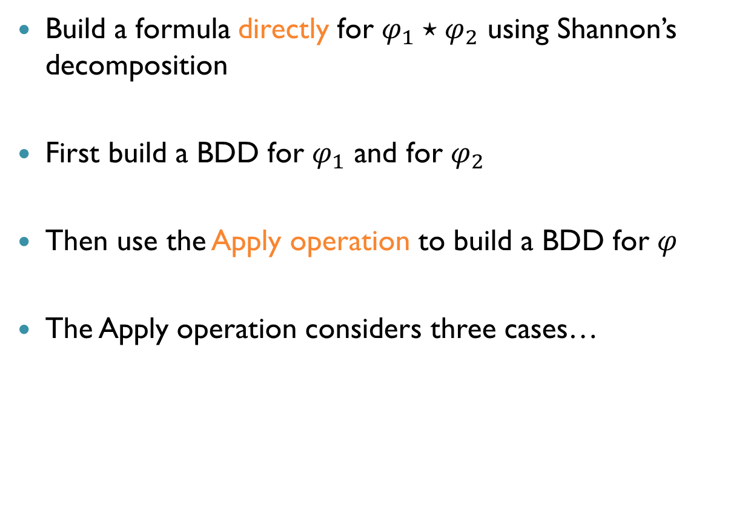
Building BDDs with Shannon’s Decomposition
Build a formula directly for $φ_{1}⋆φ_{2}$ using Shannon’s decomposition
First build a BDD for $φ_{1}$ and for $φ_{2}$
Then use the Apply operation to build a BDD for $φ$
The Apply operation considers three cases…

Slide 24
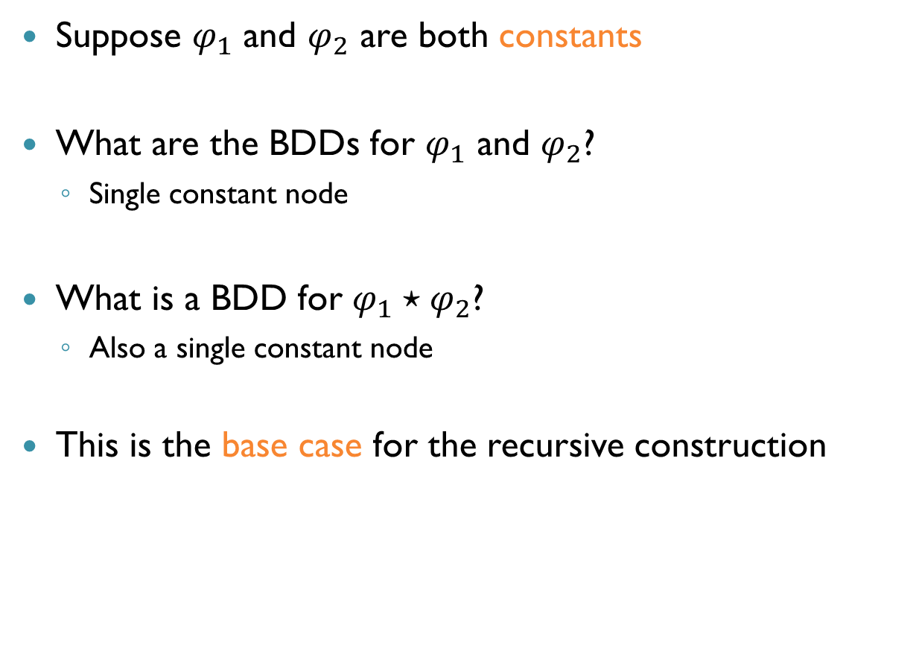

Apply: Case $\#1$
Suppose $φ_{1}$ and $φ_{2}$ are both constants
What are the BDDs for $φ_{1}$ and $φ_{2}$?
Single constant node
What is a BDD for $φ_{1}⋆φ_{2}$?
Also a single constant node
This is the base case for the recursive construction

Slide 25
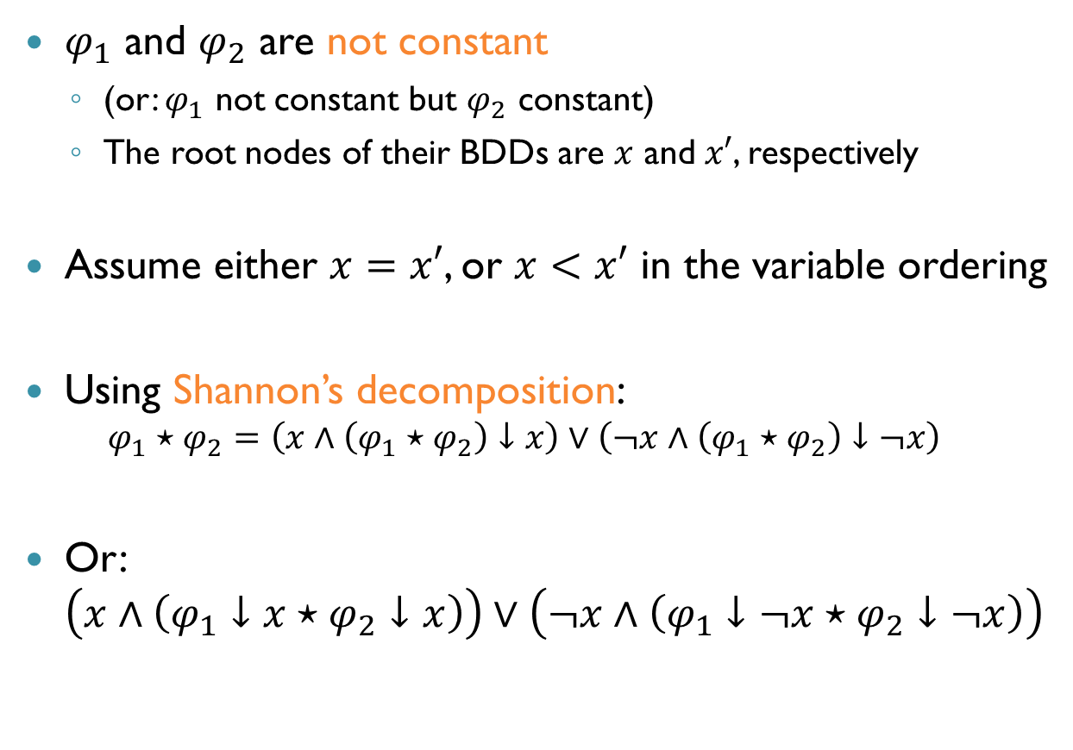

Apply: Case $\#$2
$φ_{1}$ and $φ_{2}$ are not constant
(or: $φ_{1}$ not constant but $φ_{2}$ constant)
The root nodes of their BDDs are $x$ and $x′$, respectively
Assume either $x=x′$, or $x<x′$ in the variable ordering
Using Shannon’s decomposition: $φ_{1}⋆φ_{2}=\left(x∧\left(φ_{1}⋆φ_{2}\right)↓x\right)∨\left(¬x∧\left(φ_{1}⋆φ_{2}\right)↓¬x\right)$
Or: $\left(x∧\left(φ_{1}↓x⋆φ_{2}↓x\right)\right)∨\left(¬x∧\left(φ_{1}↓¬x⋆φ_{2}↓¬x\right)\right)$

Slide 26
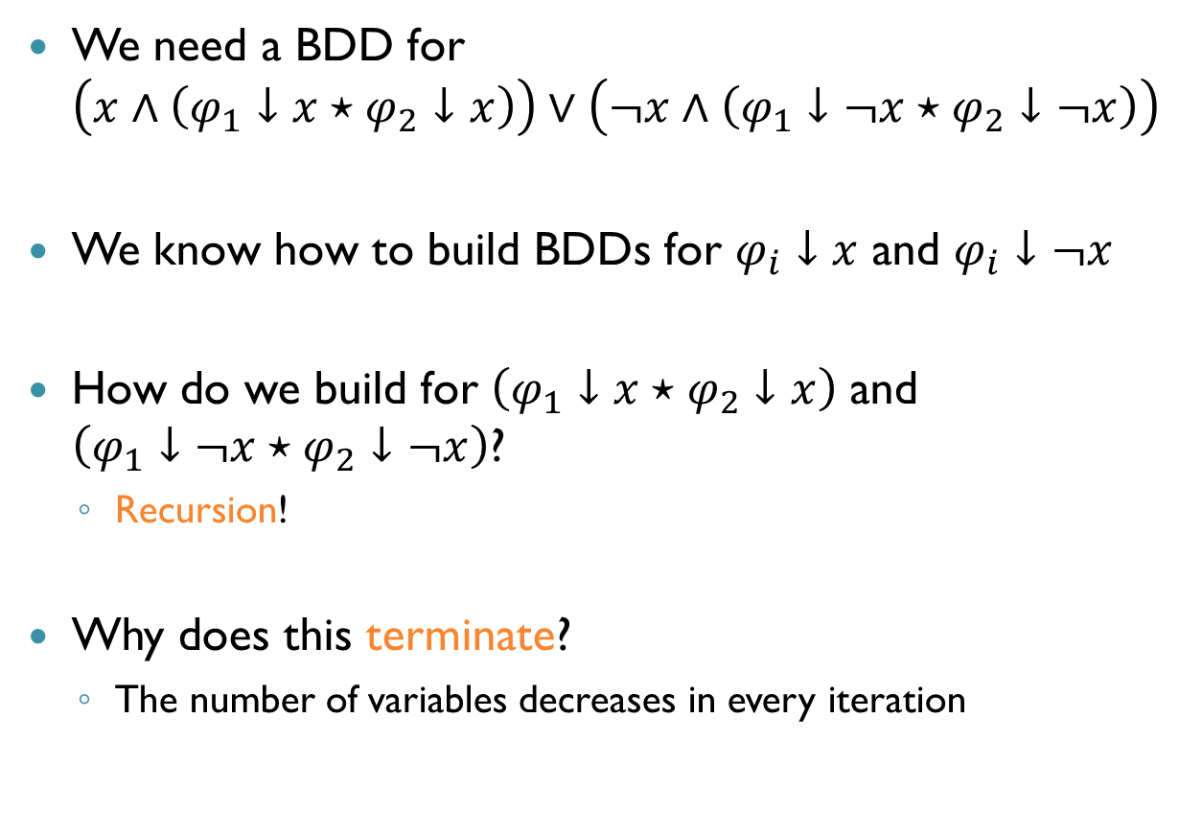

Apply: Case $\#$2 (cnt’d)
We need a BDD for $\left(x∧\left(φ_{1}↓x⋆φ_{2}↓x\right)\right)∨\left(¬x∧\left(φ_{1}↓¬x⋆φ_{2}↓¬x\right)\right)$
We know how to build BDDs for $φ_{i}↓x$ and $φ_{i}↓¬x$
How do we build for $\left(φ_{1}↓x⋆φ_{2}↓x\right)$ and $\left(φ_{1}↓¬x⋆φ_{2}↓¬x\right)$?
Recursion!
Why does this terminate?
The number of variables decreases in every iteration

Slide 27
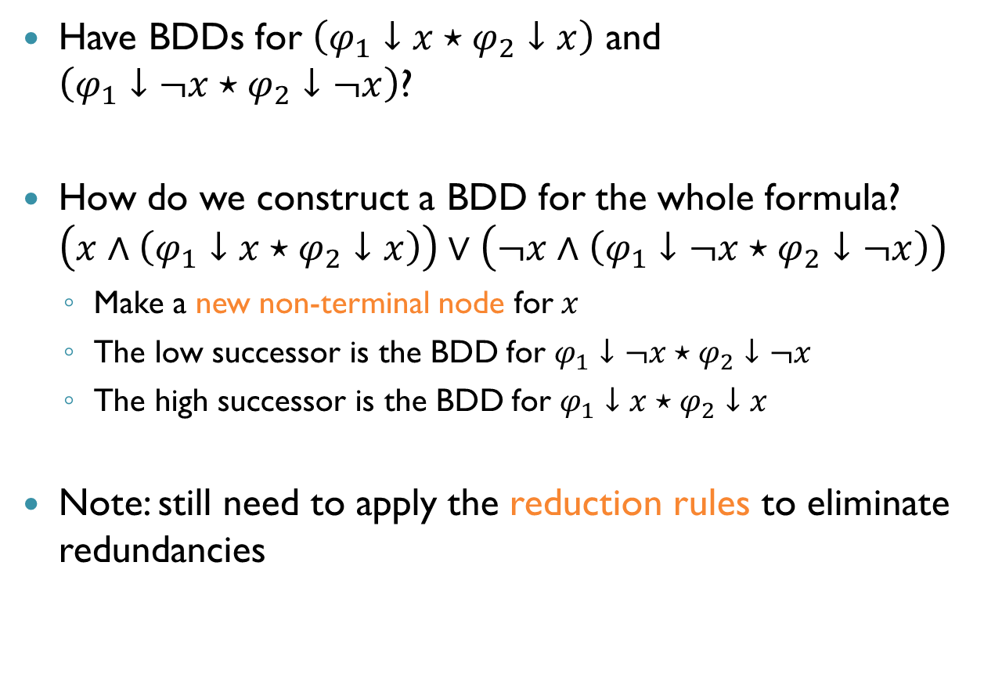
Apply: Case $\#$2 (cnt’d)
Have BDDs for $\left(φ_{1}↓x⋆φ_{2}↓x\right)$ and $\left(φ_{1}↓¬x⋆φ_{2}↓¬x\right)$?
How do we construct a BDD for the whole formula? $\left(x∧\left(φ_{1}↓x⋆φ_{2}↓x\right)\right)∨\left(¬x∧\left(φ_{1}↓¬x⋆φ_{2}↓¬x\right)\right)$
Make a new non-terminal node for $x$
The low successor is the BDD for $φ_{1}↓¬x⋆φ_{2}↓¬x$
The high successor is the BDD for $φ_{1}↓x⋆φ_{2}↓x$
Note: still need to apply the reduction rules to eliminate redundancies

Slide 28
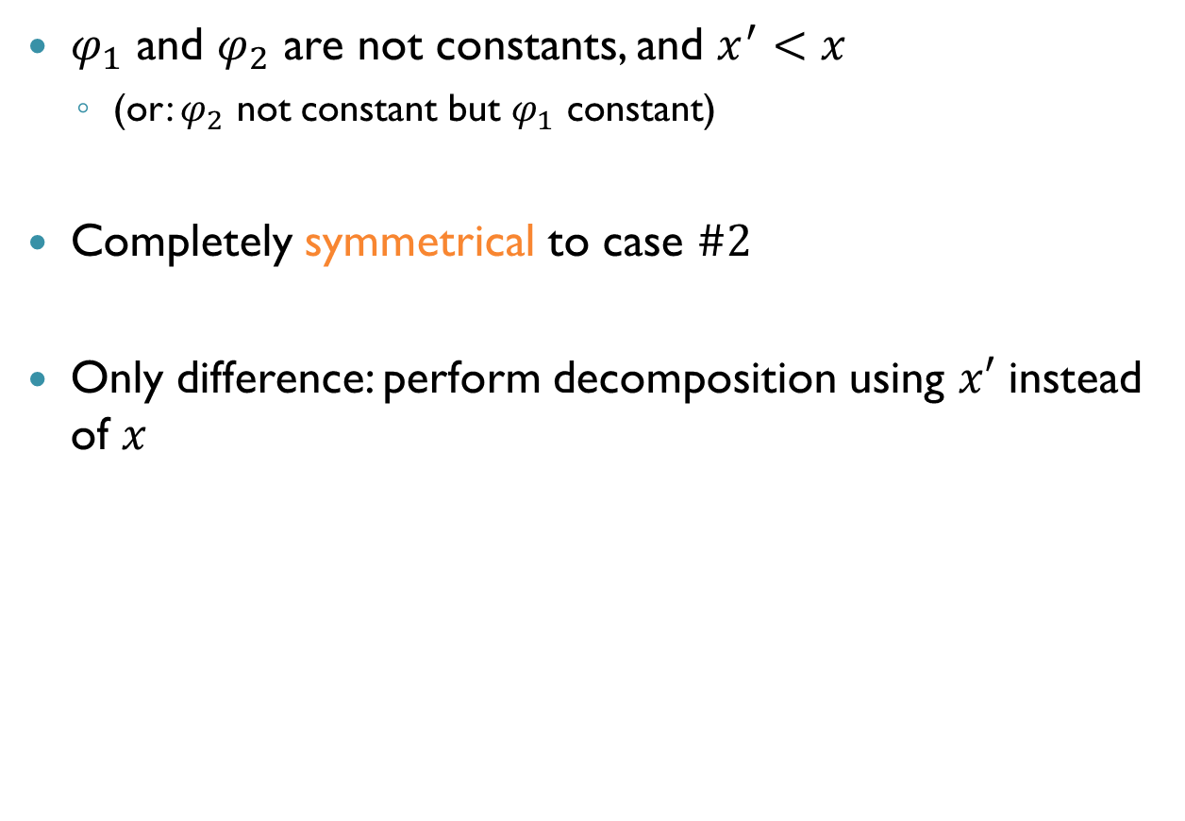

Apply: Case $\#3$
$φ_{1}$ and $φ_{2}$ are not constants, and $x^{′}<x$
(or: $φ_{2}$ not constant but $φ_{1}$ constant)
Completely symmetrical to case $\#2$
Only difference: perform decomposition using $x′$ instead of $x$

Slide 29





Example
Consider the formula $φ_{1}∨φ_{2}$ where:
$φ_{1}$ is $x_{1}↔x_{2}$
$φ_{2}$ is $¬x_{2}$
Suppose $x_{1}$ precedes $x_{2}$ is the variable order
BDD for $φ_{1}$: BDD for $φ_{2}:$
$$x_{1}$$
$$x_{2}$$
$$x_{2}$$
$$x_{2}$$
$$0$$
$$1$$
$$0$$
$$1$$

Slide 30


Example (cnt’d)
Since $x_{1}$ precedes $x_{2}$, this is case $\#2$
Split on $x_{1}$
Recursively compute $\left(φ_{1}↓x_{1}∨φ_{2}↓x_{1}\right)$ and $\left(φ_{1}↓¬x_{1}∨φ_{2}↓¬x_{1}\right)$
Once done, the BDD will be:
$$x_{1}$$
BDD for negative cofactor
BDD for positive cofactor

Slide 31

Example (cnt’d)
Positive cofactor: $φ_{1}↓x_{1}∨φ_{2}↓x_{1}$
Still not the base case, so we need recursion!
Denote: $φ_{3}=φ_{1}↓x_{1}$, $φ_{4}=φ_{2}↓x_{1}$, compute $φ_{3}∨φ_{4}$
By recursion, this is: $\left(x_{2}∧\left(φ_{3}↓x_{2}∨φ_{4}↓x_{2}\right)\right)∨\left(¬x_{2}∧\left(φ_{3}↓¬x_{2}∨φ_{4}↓¬x_{2}\right)\right)$
$$x_{1}$$
$$x_{2}$$
$$x_{2}$$
$$x_{2}$$
$$0$$
$$1$$
$$0$$
$$1$$

Slide 32
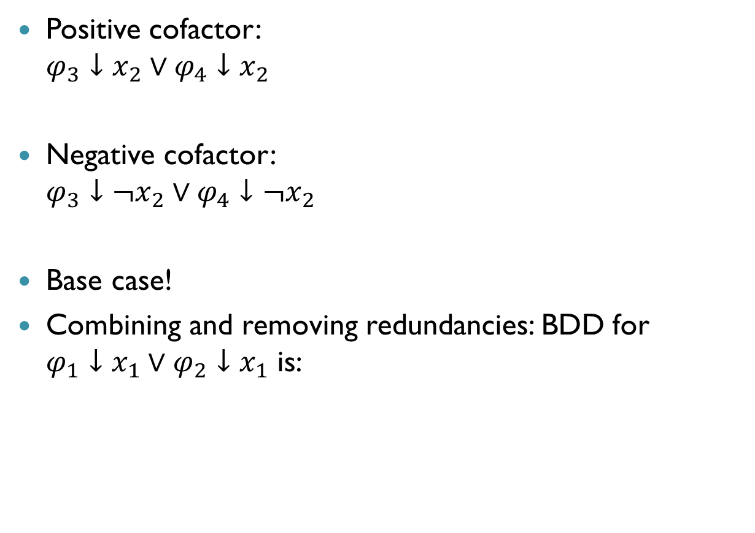

Example (cnt’d)
$$x_{2}$$
$$x_{2}$$
Positive cofactor: $φ_{3}↓x_{2}∨φ_{4}↓x_{2}$
Negative cofactor: $φ_{3}↓¬x_{2}∨φ_{4}↓¬x_{2}$
Base case!
Combining and removing redundancies: BDD for $φ_{1}↓x_{1}∨φ_{2}↓x_{1}$ is:
$$0$$
$$1$$
$$0$$
$$1$$
$$x_{2}$$
$$x_{2}$$
$$0$$
$$1$$
$$0$$
$$1$$
$$x_{2}$$
$$1$$
$$1$$

Slide 33

Example (cnt’d)
Negative cofactor: $φ_{1}↓¬x_{1}∨φ_{2}↓¬x_{1}$
Need recursion
Denote: $φ_{5}=φ_{1}↓¬x_{1}$, $φ_{6}=φ_{2}↓¬x_{1}$, compute $φ_{5}∨φ_{6}$
$$x_{1}$$
$$x_{2}$$
$$x_{2}$$
$$x_{2}$$
$$0$$
$$1$$
$$0$$
$$1$$

Slide 34

Example (cnt’d)
$$x_{2}$$
$$x_{2}$$
Positive cofactor: $φ_{5}↓x_{2}∨φ_{6}↓x_{2}$
Negative cofactor: $φ_{5}↓¬x_{2}∨φ_{6}↓¬x_{2}$
Base case!
BDD for $φ_{1}↓¬x_{1}∨φ_{2}↓¬x_{1}$ is:
$$0$$
$$1$$
$$0$$
$$1$$
$$x_{2}$$
$$x_{2}$$
$$0$$
$$1$$
$$0$$
$$1$$
$$x_{2}$$
$$0$$
$$1$$

Slide 35

Example (cnt’d)
Back to first recursive call:
And this is the final BDD for the original formula $\left(x_{1}↔x_{2}\right)∨¬x_{2}$
$$x_{1}$$
BDD for negative cofactor
BDD for positive cofactor
$$x_{2}$$
$$0$$
$$1$$

Slide 36
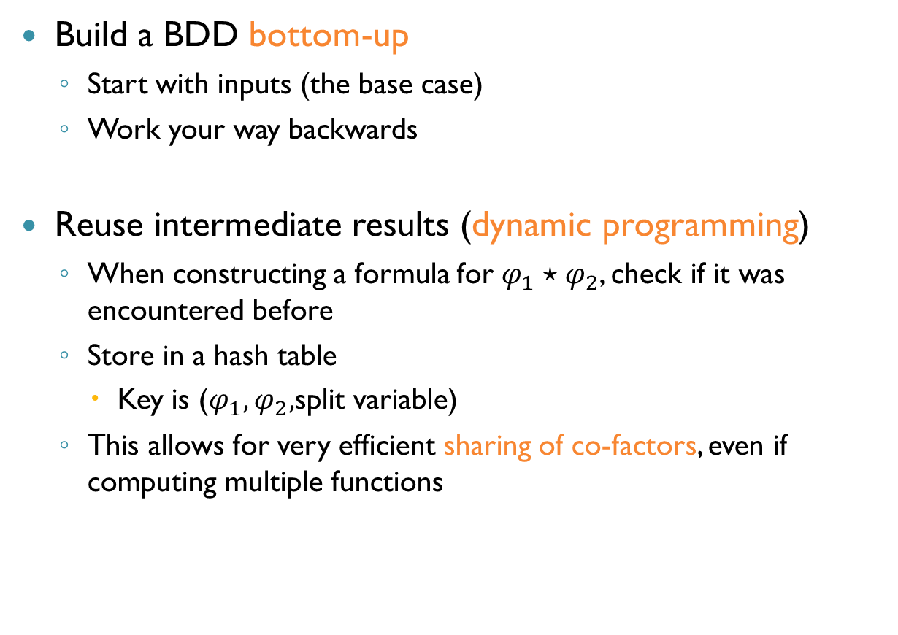
Constructing BDDs in Practice
Build a BDD bottom-up
Start with inputs (the base case)
Work your way backwards
Reuse intermediate results (dynamic programming)
When constructing a formula for $φ_{1}⋆φ_{2}$, check if it was encountered before
Store in a hash table
Key is ($φ_{1},φ_{2},$split variable)
This allows for very efficient sharing of co-factors, even if computing multiple functions

Slide 37
Why Are BDDs Useful?
So far: learned how to construct BDDs
Coming up next: what can you do with BDDs?

Slide 38
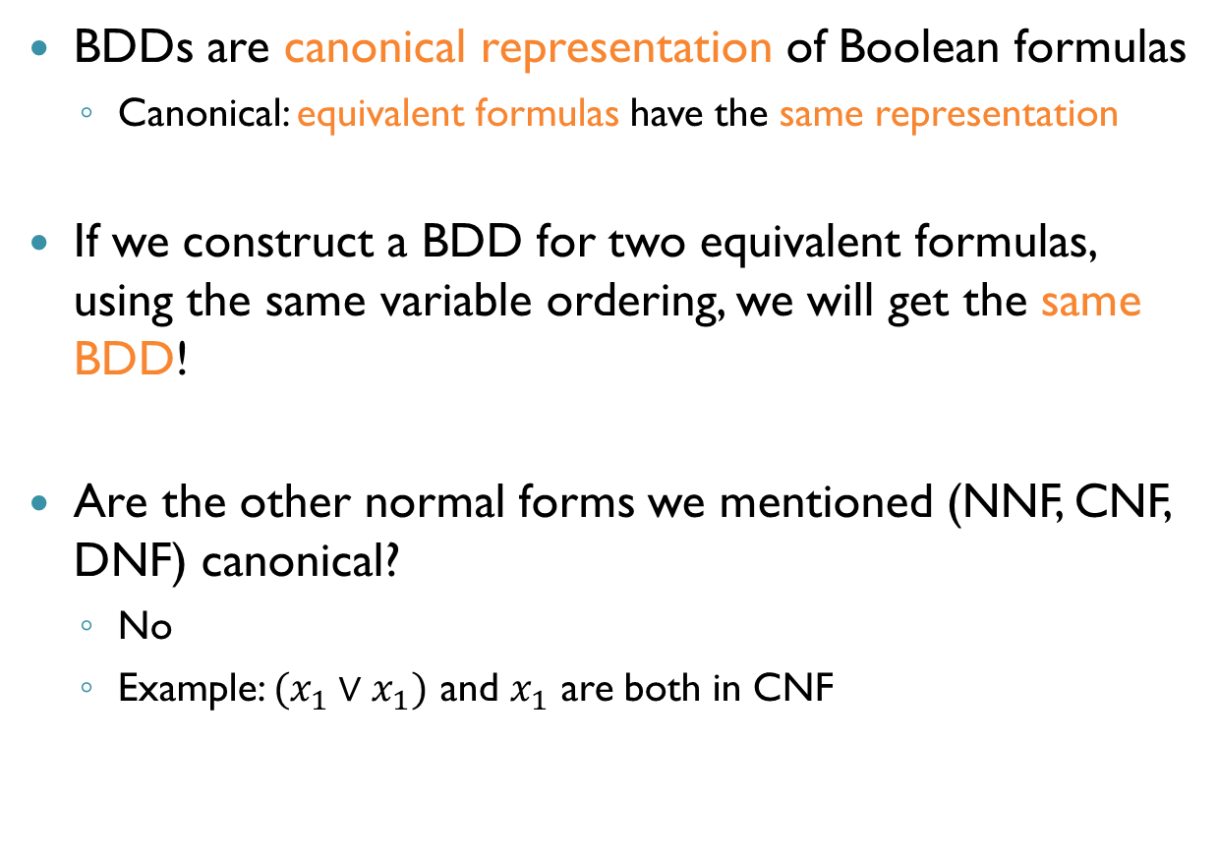
Canonicity
BDDs are canonical representation of Boolean formulas
Canonical: equivalent formulas have the same representation
If we construct a BDD for two equivalent formulas, using the same variable ordering, we will get the same BDD!
Are the other normal forms we mentioned (NNF, CNF, DNF) canonical?
No
Example: $(x_{1}∨x_{1})$ and $x_{1}$ are both in CNF

Slide 39
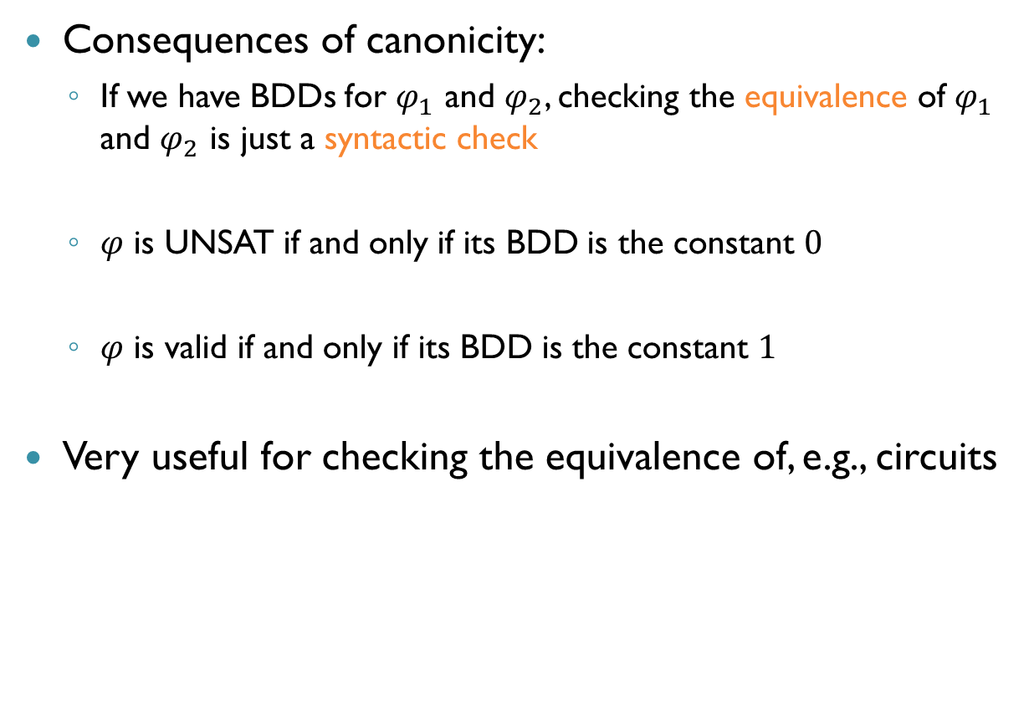
Canonicity (cnt’d)
Consequences of canonicity:
If we have BDDs for $φ_{1}$ and $φ_{2}$, checking the equivalence of $φ_{1}$ and $φ_{2}$ is just a syntactic check
$φ$ is UNSAT if and only if its BDD is the constant $0$
$φ$ is valid if and only if its BDD is the constant $1$
Very useful for checking the equivalence of, e.g., circuits

Slide 40


Satisfiability
A BDD can be used to find (un)satisfying assignments for the formula
SAT:
$x_{1}=x_{2}=T$
$x_{1}=x_{3}=T, x_{2}=F$
$$x_{1}$$
$$x_{2}$$
$$x_{3}$$
$$0$$
$$1$$

Slide 41
Variable Ordering and Sizes
BDD size is very sensitive to variable ordering!
One ordering can lead BDD size polynomial in formula size
Another ordering can lead to an exponential size!
For some formulas, any ordering leads to an exponential blowup
Finding an optimal ordering is NP-complete
So, use heuristics
Static (ordering predetermined)
Dynamic (ordering changes during construction)

Slide 42
Static Variable Ordering
Use heuristics to find a good order
Example:
Interleave bit of operands of operators
Operand-specific orders
Addition: low-order to high-order, or vice versa
Control variables on top
Variables that completely change functional behavior should come first

Slide 43



Dynamic Variable Ordering
Change ordering as BDD operations proceed
Again, many heuristics proposed
Rudell’s sifting: swap two adjacent variables
$$x_{1}$$
$$x_{2}$$
$$x_{2}$$
$$x_{2}$$
$$x_{1}$$
$$x_{1}$$
$$0$$
$$1$$
$$0$$
$$1$$

Slide 44
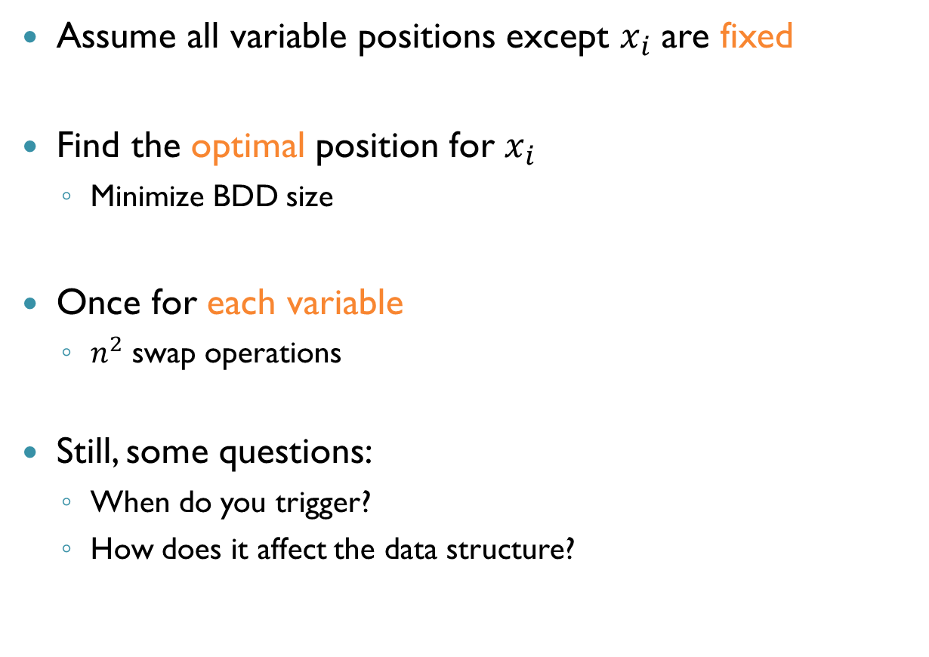
Dynamic Variable Ordering (cnt’d)
Assume all variable positions except $x_{i}$ are fixed
Find the optimal position for $x_{i}$
Minimize BDD size
Once for each variable
$n^{2}$ swap operations
Still, some questions:
When do you trigger?
How does it affect the data structure?

Slide 45
Dynamic Variable Ordering (cnt’d)
Sifting (and others) enabled a leap in BDD effectiveness
Can be quite slow
Sometimes, for a particular problem, you can save the ordering discovered and re-use it

Slide 46
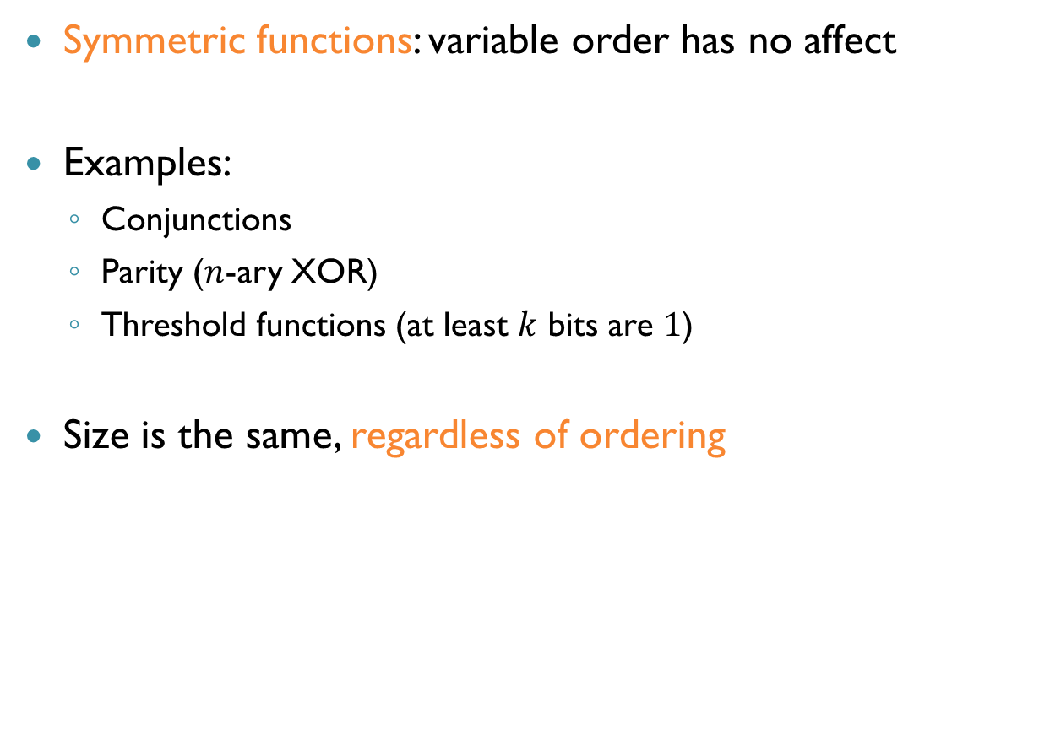
BDDs for Symmetric Functions
Symmetric functions: variable order has no affect
Examples:
Conjunctions
Parity ($n$-ary XOR)
Threshold functions (at least $k$ bits are $1$)
Size is the same, regardless of ordering

Slide 47
Symmetric Functions: Examples
Majority function: output is the majority value of inputs
$$x_{1}$$
$$x_{2}$$
$$x_{2}$$
$$x_{3}$$
$$0$$
$$1$$

Slide 48

Symmetric Functions: Examples
Parity function: $1$ if and only if odd number of true variables
Intuition: only need to remember the number of $1$s so far
$$x_{1}$$
$$x_{2}$$
$$x_{2}$$
$$x_{3}$$
$$x_{3}$$
$$0$$
$$1$$

Slide 49
Reachability
Model checking of safety properties:
Construct a program’s transition system
Check if there are any reachable bad states
Bounded model checking: only explore a portion of the graph
BDDs give us another way for doing reachability analysis

Slide 50



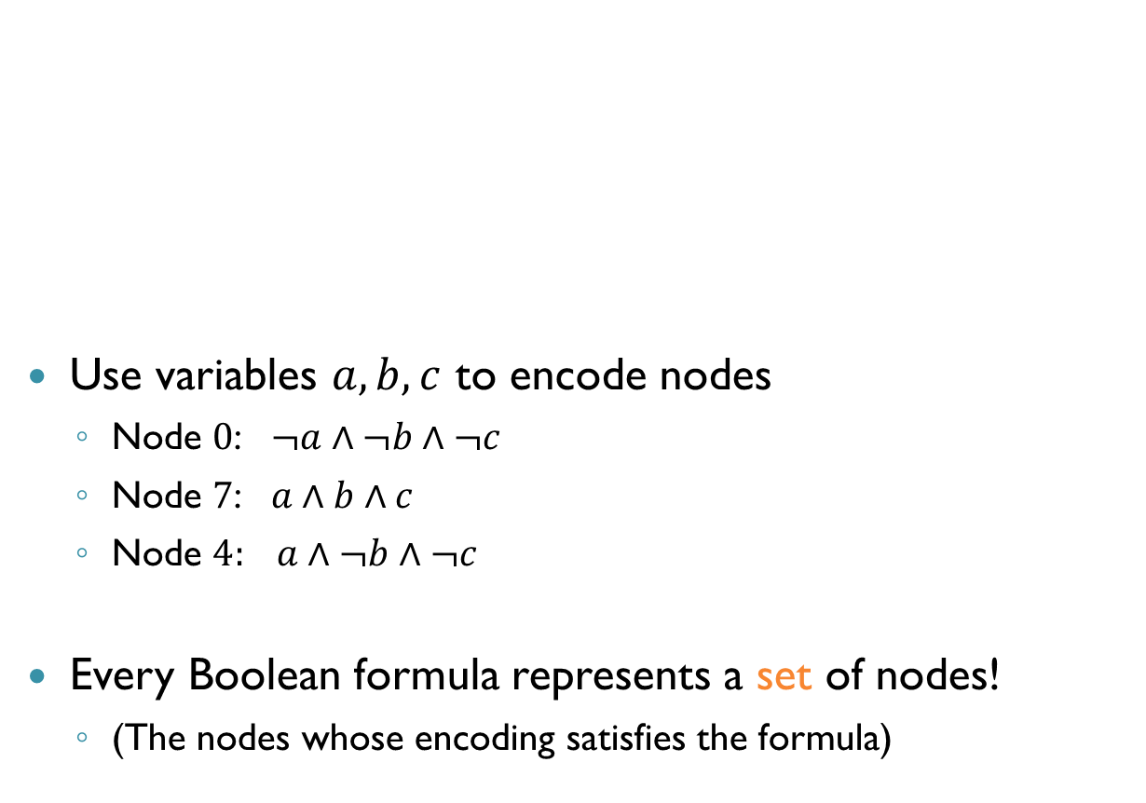





Reachability: Encoding States
$$1$$
$$3$$
$$5$$
Use variables $a,b,c$ to encode nodes
Node $0$: $¬a∧¬b∧¬c$
Node $7$: $a∧b∧c$
Node $4:$ $a∧¬b∧¬c$
Every Boolean formula represents a set of nodes!
(The nodes whose encoding satisfies the formula)
$$0$$
$$7$$
$$2$$
$$4$$
$$6$$

Slide 51

Reachability: Encoding States (cnt’d)
$$1$$
$$3$$
$$5$$
$a∧b∧¬c=\left\{6\right\}$
$a∧b= ?$
$\left\{6,7\right\}$
$a⊕b=?$
$\{2,3,4,5\}$
$$0$$
$$7$$
$$2$$
$$4$$
$$6$$

Slide 52
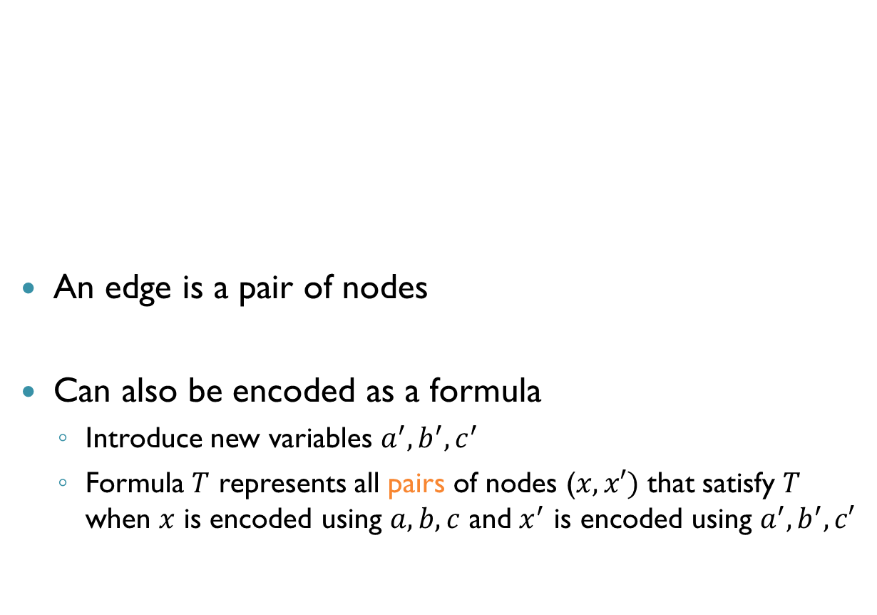
Reachability: Encoding Edges
$$1$$
$$3$$
$$5$$
An edge is a pair of nodes
Can also be encoded as a formula
Introduce new variables $a^{′},b^{′},c^{′}$
Formula $T$ represents all pairs of nodes ($x,x′)$ that satisfy $T$ when $x$ is encoded using $a,b,c$ and $x^{′}$ is encoded using $a^{′},b^{′},c′$
$$0$$
$$7$$
$$2$$
$$4$$
$$6$$

Slide 53

Reachability: Encoding Edges (cnt’d)
$$1$$
$$3$$
$$5$$
Edge from $0$ to $1$:
$¬a∧¬b∧¬c∧¬a^{′}∧¬b^{′}∧c′$
Edge from $5$ to $2$:
$a∧¬b∧c∧¬a^{′}∧b^{′}∧¬c^{′}$
The set of these two edges:
$\left(¬a∧¬b∧¬c∧¬a^{′}∧¬b^{′}∧c^{′}\right)∨$ $\left(a∧¬b∧c∧¬a^{′}∧b^{′}∧¬c^{′}\right)$
$$0$$
$$7$$
$$2$$
$$4$$
$$6$$

Slide 54
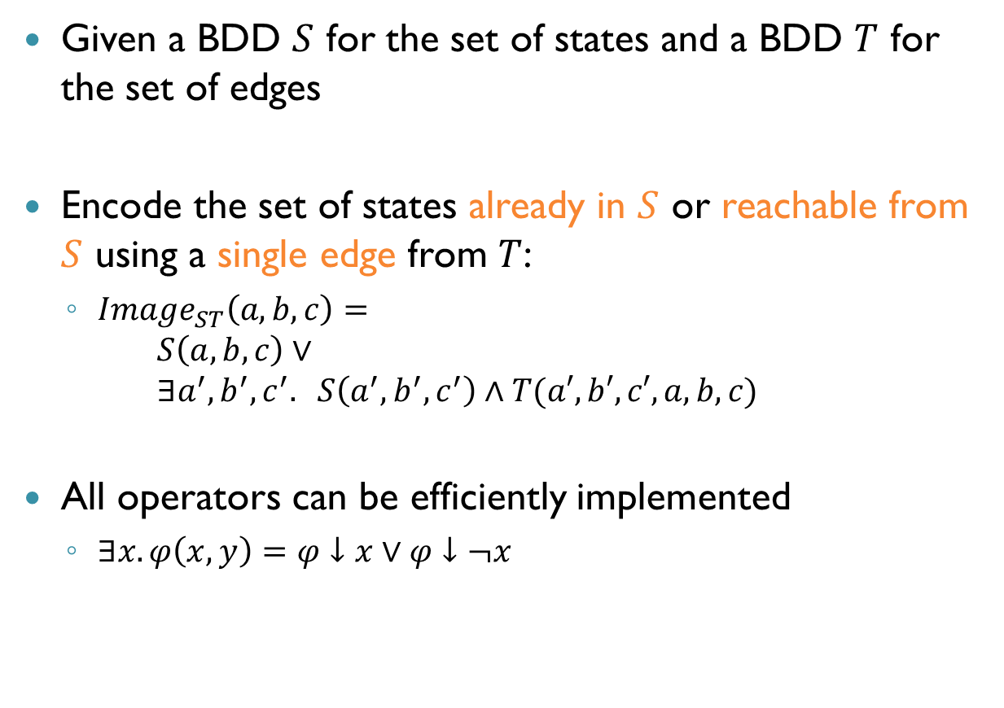
Reachability: Images
Given a BDD $S$ for the set of states and a BDD $T$ for the set of edges
Encode the set of states already in $S$ or reachable from $S$ using a single edge from $T$:
$Image_{ST}\left(a,b,c\right)=$ $S\left(a,b,c\right)∨$ $∃a^{′},b^{′},c^{′}. S\left(a^{′},b^{′},c^{′}\right)∧T(a′,b′,c′,a,b,c)$
All operators can be efficiently implemented
$∃x.φ\left(x,y\right)=φ↓x∨φ↓¬x$

Slide 55
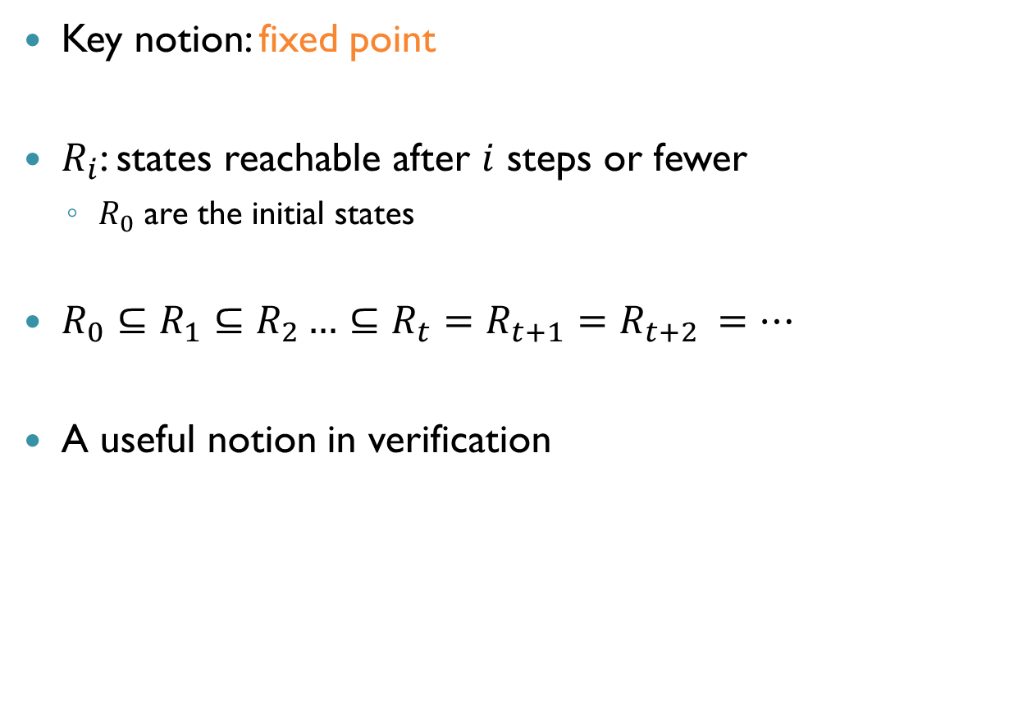
Reachability: Algorithm
Key notion: fixed point
$R_{i}$: states reachable after $i$ steps or fewer
$R_{0}$ are the initial states
$R_{0}⊆R_{1}⊆R_{2}…⊆R_{t}=R_{t+1}=R_{t+2 }=…$
A useful notion in verification

Slide 56
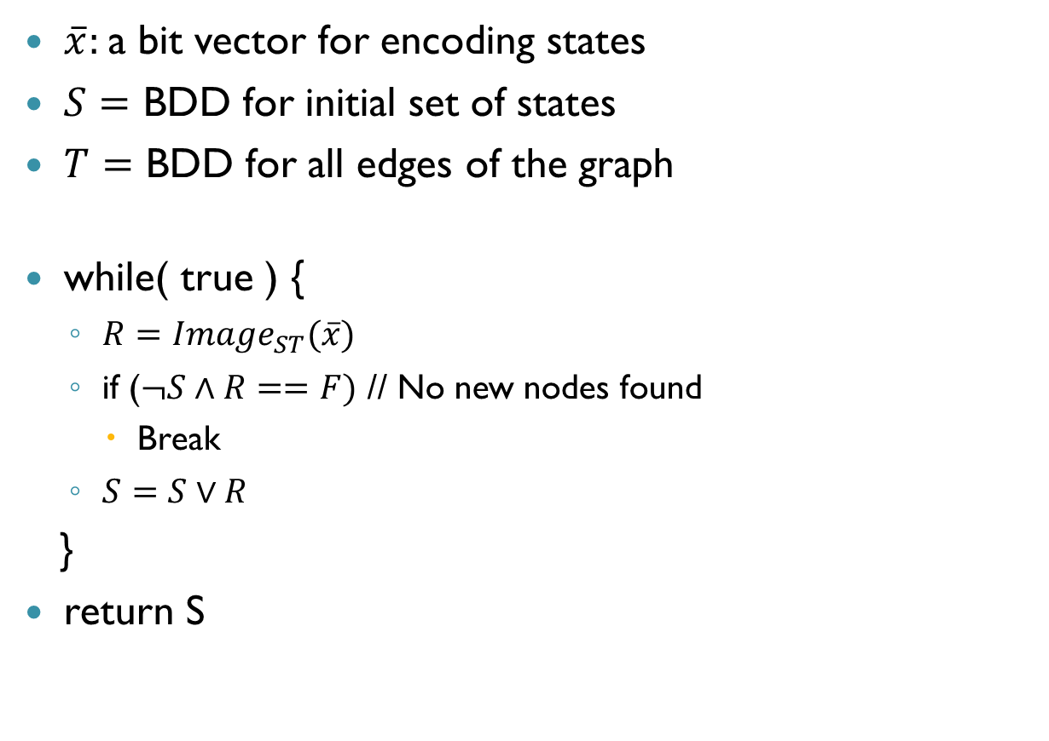
Reachability: Algorithm (cnt’d)
$\overline{x}:$ a bit vector for encoding states
$S=$ BDD for initial set of states
$T=$ BDD for all edges of the graph
while( true ) {
$R=Image_{ST}(\overline{x})$
if ($¬S∧R==F)$ // No new nodes found
Break
$S=S∨R$
}
return S

Slide 57
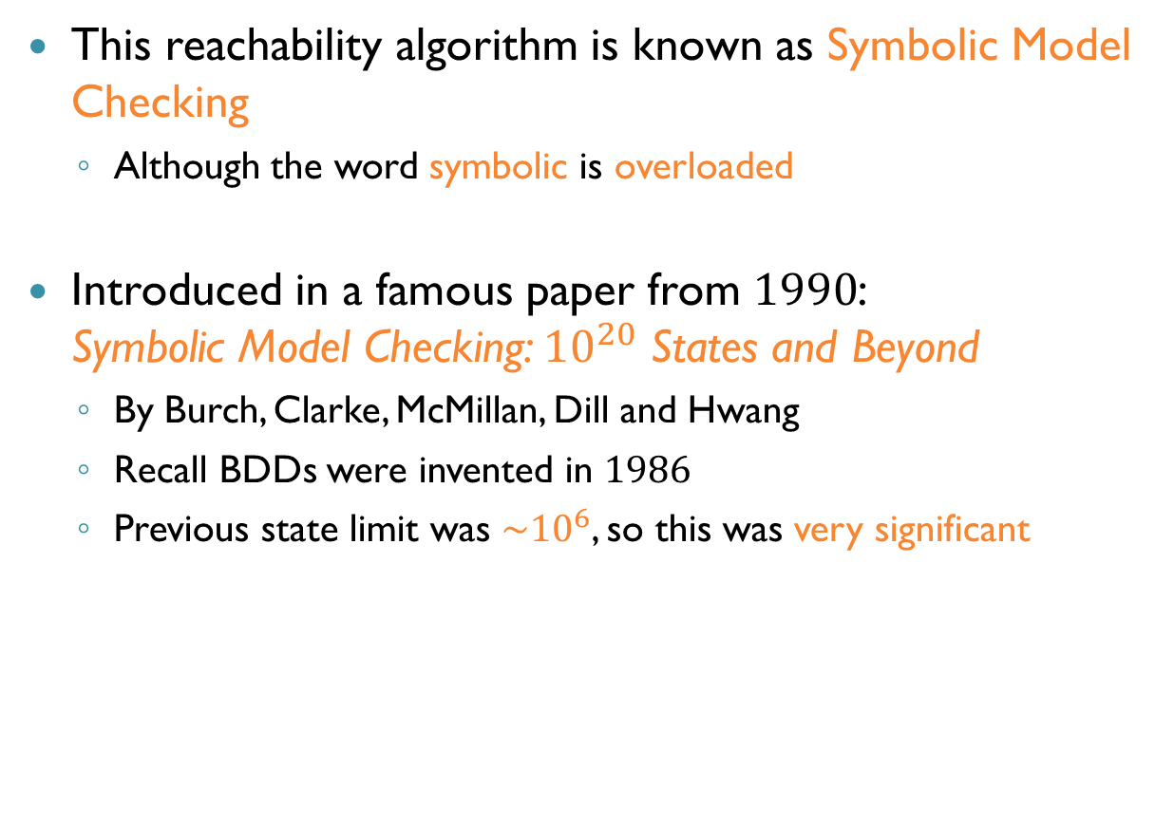
Symbolic Model Checking
This reachability algorithm is known as Symbolic Model Checking
Although the word symbolic is overloaded
Introduced in a famous paper from $1990$: Symbolic Model Checking: ${10}^{20}$ States and Beyond
By Burch, Clarke, McMillan, Dill and Hwang
Recall BDDs were invented in $1986$
Previous state limit was $\sim {10}^{6}$, so this was very significant

Slide 58
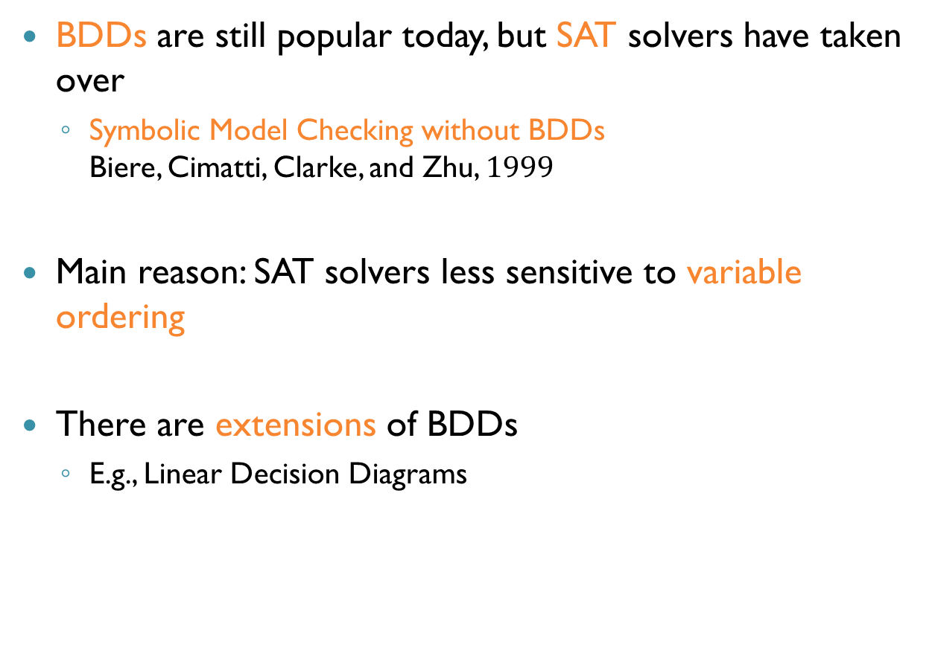
BDDs Today
BDDs are still popular today, but SAT solvers have taken over
Symbolic Model Checking without BDDs Biere, Cimatti, Clarke, and Zhu, $1999$
Main reason: SAT solvers less sensitive to variable ordering
There are extensions of BDDs
E.g., Linear Decision Diagrams

